Slide 1
Interview Skills

Slide 2
Interviews Skills
1. Interviewing skills for Managers
2. Interview skills for an employee

Slide 3
Purpose of an Interview
An interview is a two-way exchange, a conversation, in which both participants have some goals.
The Interviewer wants to determine:
Can the candidate do the job?
Will the candidate fit in?
Is this the best candidate for the position?
The Interviewee wants to determine:
Do I want this job?
Can I do this job?
Does this job offer me the opportunities I want for advancement or experience?

Slide 4
1. Interviewing Skills for Managers

Slide 5
1. Interviewing Skills for Managers
Outline
Introduction
Preparing for the Interview
The Interview
Communicating effectively
After the interview

Slide 6
1. I.S. for Managers-Introduction
Job interviews are an essential part of making a sound hiring decision.
Why is interviewing so important?
After narrowing down the talent pool, the most qualified applicants are met.
Job interviews supply:
firsthand information about a candidate’s career,
work experience and skill level,
Attributes such as, a general sense of overall intelligence, aptitude, enthusiasm and attitude — and how those attributes match up to the requirements of the job.
insight into the candidate's basic personality traits, motivation to tackle the responsibilities of the job, desire to become a part of the company and ability to integrate into the current work team.

Slide 7
I.S. for Managers-Introduction
I. Prepare yourself for the Role:
Know what you are looking for in a candidate
Know what you really want from the candidate- have a detailed job description and person specification.
Learn about the organization’s vision.
Carefully review the candidate's cover letter, resume, background information and references.
keep questions focused and relevant so they are tailored to individual job candidates.
II. Skills required to be an interviewer:
Active listening
Verbal: Tone, clarity, volume, pitch
Non verbal communication skills

Slide 8
2. I.S. for Managers- Preparing for the Interview
I. The interviewing Panel
If It`s a panel interview, the panel needs to meet beforehand and discuss interview tactics.
Ideally, the interviewers (or panel) should carry out the short-listing for the interview, comparing the individual members’ scores for each candidate and agreeing on a panel score.
The panel then need to agree what questions should be asked and who is going to ask which questions, or cover which areas. It’s also helpful to discuss which areas are most important in case some areas have to be left unexamined.
Finally, the panel needs to agree on what a ‘good’ answer to any particular question will look like, and how far they are prepared to probe to try to obtain one.

Slide 9
I.S. for Managers- Preparing for the Interview
II. Your responsibilities before the Interview
Select the right job requirements
Develop structured interview questions
Craft useful rating scales
Assemble an effective hiring team
Arrange for a queit meeting place

Slide 10
I.S. for Managers-Preparing for the Interview
III. Your responsibilities after the Interview
Let the interviewee ask questions
Calculate marks according to the rating scale
Ask for additional questions
Explain notification procedure
Give an expected start date for the job
Describe the next steps
Thank candidates for coming
Escort them to main reception area

Slide 11
3. I.S. for Managers- The Interview
1. Building Rapport with the Candidate
One interviewer leads the interview, he/she should:
Introduce the members in panel and outline the process of the interview.
Explain broadly what the interview is going to cover and who is going to ask questions.
Explain what other members of the panel will be doing: making notes, observing, or perhaps adding supplementary questions.
Start off the process with a simple question such as ‘Tell us what you do in your current job’.

Slide 12
I.S. for Managers- The Interview
2. Asking the Right questions
Interview questions generally take three forms: experience, hypothetical & personal awareness.
Experience- or competence-based questions
These questions are designed to explore what the candidate has done, and the skills that they have previously demonstrated. They take the form:
“Tell me about a time when you….”
“Can you tell me how you have gone about solving a particular problem that you have faced at work?”
DRAWBACK: They don’t explore potential. Experience done may not translate to your organization or your job.
It`s hard for less experienced candidates to demonstrate the skills from the past.
Therefore: use a few hypothetical-problem-solving questions.

Slide 13
I.S. for Managers- The Interview
II. Hypothetical questions
Questions related to handling situations the candidate will face in the post.
You may provide them with a written statement of the problem, half a page of bullet points, or just outline it to them, and ask them to consider what they would do to address the problem.
Candidate presentations are also used. Ask the candidates to present on what they see as the first five issues to be addressed in the job and how they would go about doing so.

Slide 14
I.S. for Managers- The Interview
III. personal awareness questions
Questions designed to know whether candidate knows oneself and is fit for the job or not.
For example, you might ask the candidate to tell you what motivates them, or what strengths they bring to the job. Good questions of this type ask the candidate to rank their requirements or strengths. This enables you to assess how personally aware they are, and also whether you can provide the necessary motivation and/or use their strengths.
“Please tell us, in descending order, the top five factors that keep you motivated on the job”
“Tell us the most effective ways of managing you”

Slide 15
4. I.S. for Managers- After the Interview
Be Fair and Transparent.
Make final decision based on the scores you have given to each candidate.
If interviewer(s) feels that the ‘wrong’ candidate has emerged as successful then it’s helpful to examine why this is so.
Have you missed a key job skill? Or was there something that they said which should have resulted in a lower score?
Revisit the process and come up with a different answer, as long as you can justify it in the event of an appeal by the candidate.
At this stage, the role of the independent assessor, if there is one, is to ensure that the process is fair to all candidates.

Slide 16
Interview Skills for an Employee

Slide 17
2. Interview Skills for an Employee
Interview = A meeting with an objective
Employer’s objective is to find the best person for the job
Employer: reviews candidate’s experience and abilities
Can you do the job? (skills, abilities, qualifications)
Will you do the job? (interest, attitude & motivation)
How will you fit into the organisation? (personality)
You: impress employer and assess position on offer
What does this position offer me?
How does it fit with my career plans?

Slide 18
Preparation is the key to success
Review own skills, experiences and qualities
Check CV
Anticipate questions and identify relevant examples
Prepare key selling points
Research organisation
Websites, reports, articles, company literature, etc
Contacts with knowledge of organisation or sector
Relevant articles in the press
Personal visit or telephone call
Research job and occupational area
Job description – or similar
Current issues
Prepare your questions
Practice

Slide 19
Stages of an Interview
There are three stages:
Before the interview
During the interview
After the interview

Slide 20
Before the Interview
Read about the job/occupation.
Interview people in the department
Build your network
Practice interviewing
Dress for success
Visit the organization
Have an agenda, know what you want the interviewer to learn about you
Anticipate what questions will be asked
Know your Knowledge, Skills, Abilities and Accomplishments
Relate your KSAs to the position for which you are applying
Know who is interviewing you
Prepare and practice answers to typical questions

Slide 21
During the Interview
RELAX!
Answer the questions using the “PROVE IT” Method
Ask intelligent questions about the organization
Don’t volunteer negative information about yourself
Be honest
Have eye contact with the interviewer
Be believable, be yourself
Say positive things about your former supervisors and working conditions
Find ways to let the interviewer know you are a team player

Slide 22
The PROVE IT method: P-Preview the questions. R-Read the question/passage carefully. O-Omit wrong and impossible answers. V-Verify facts or clues E-Explain I-Infer answers that are not directly given. (Use the clues) T-Test your answer. Does it make sense?

Slide 23
After the Interview
Evaluate the interview
Write a thank you note to the interviewer
Follow up
Contact the interviewer for feedback
Express your interest in the position even after the position is filled

Slide 24
Watch the Body Language
First impressions very powerful
Allow time to relax
Dress appropriately
Entrance, introductions & handshake
Smile and make eye contact
Be aware of own movements
Watch body language of interviewer

Slide 25
Typical Questions
About you
Tell me about yourself - Bring me up to date with your CV?
Why did you choose that particular degree programme?
What experience have you had that is relevant to this post?
What would you consider your major achievements to date?
About the job
What interests you about this job?
What do you know about this organisation?
What other options are you considering?
How do you see your career developing – 5 years?
If you were Head of Department, what would be your priorities?
General knowledge
What do you think of the Government’s policy on college fees?
What’s your opinion of the Ryanair bid for Aer Lingus?

Slide 26
Other Type of Questions
“What if” Questions
No experience - how are you likely to respond to a situation
Probing Questions
How exactly did you deal with the situation?
How did you know it worked?
How did you feel about the outcome?
Could you have handled it differently?

Slide 27
Types of Interviews
Remote interviews
In-person interviews
Team interviews
Stress interviews
Case interviews
Competency Based interviews

Slide 28

1. Remote Interviews
A remote interview is typically done early in the interviewing process and it is typically a screening interview.
It might be over the phone, Skype, or video conference.
The primary objective of the screening interview is to remove you from active consideration before scheduling an in-person interview.
Common reasons for being weeded out at this stage include:
discrepancies between your resume and actual experience
poor verbal communication skills
or lack of the qualifications outlined in the organization's job description.

Slide 29

2. In-person interviews
The in-person interview is on-site at the company's location.
Panel
Team of people
Hiring Manager

Slide 30

3. Team interviews/ panel interview.
A unique format.
Typically you meet with a group of interviewers around a table in a conference room.
Members of panel may be from your prospective department or may be a cross-section of employees from throughout the company.
It`s most important to make eye contact with everyone on the panel, even when responding to a question posed by an individual panelist.
Treat every member of the team with the same respect you would give to the hiring manager.

Slide 31

4. Stress interviews
The stress interview is a specific format designed to evaluate how you respond to hostility, terrible conditions, and to find out how you handle stress and pressure.
The interviewer snarls at you and asks you, so why the hell should I hire you for anything?
Some companies use these interviews, these stress interviews.

Slide 32

Stress Interviews...continued
Here, the interviewer(s):
Will glare at you, or fire questions that are rude, rapid pace.
Ridicules everything you say or challenges every answer.
Stares out the window and seems to be completely uninterested in anything you have to say.
These are deliberate tactics to subject you to stress.

Slide 33
Surviving stress interviews
Remain calm
keep a sense of humor
avoid getting angry or defensive.
It's a game to see if you will become depressed, hostile, or upset when facing adversity.

Slide 34

5. Case Interviews
A case interview is a job interview in which the applicant is presented with a challenging business scenario that he/she must investigate and propose a solution to.
Case interviews are designed to test the candidate's analytical skills and "soft" skills within a realistic business context.

Slide 35
6. Competency-based Interviews
Company identifies key skills required for job; Designs questions to elicit evidence of skills and emphasis on past behaviour as predictor of success
NEEDED SKILLS AND TECHNIQUES TO BE UTILIZED
Teamwork: Describe a team project you worked on. What problems arose? How did you deal with them?
Communication Skills: Describe situation when you had to persuade others to support your view. Give an example of any reports you’ve written which illustrate your writing skills
Interpersonal skills: What kinds of people do you find it difficult to work with? How do you handle those situations?
Taking Responsibility: Describe a time when you took responsibility to achieve a challenging goal
Problem-solving: Tell about a time when you had several tasks to manage at one time with conflicting deadlines.

Slide 36
Preparing for Competency Interview
Identify the competencies required for job
Review job description or ask for information
Define each competency in behavioural terms
Identify past experience to illustrate how you demonstrated that behaviour
Prepare examples for each competency
Practice talking about your experience
Try to give a complete answer – Use STAR modal.

Slide 37
Responding to Competency Q
Q. Give me an example of a problem you encountered. How did you approach it. What was the outcome?
STAR response
S: Describe the situation
T: Explain the task/problem that arose
A: What action did you take?
R: What was the result or outcome?
What did you learn from this experience?

Slide 38
Matching Skills to Requirements
Employer needs | Your evidence
Communication Team work Leadership Initiative Customer Care IT Commercial awareness | Presentation to class Example of any project Students societies, Committees etc. Fundraising for charity Working in some service. Designed website Business pages

Slide 39
How to Answer
Listen carefully, seek clarification
Illustrate answers with real examples and evidence
Be positive – constructive criticism
Keep answers specific and succinct
Take time to respond
Be alert to interviewer’s body language
Speak clearly, smile and show enthusiasm
Know what you want to say, and find the opportunity

Slide 40
Qualities Employers Seek
Good all-round intelligence
Enthusiasm, commitment and motivation
Good communication skills
Team work ability
Ability to solve problems
Capacity to work hard
Initiative and self-reliance
Balanced personality

Slide 41
Competencies required by X Company
Adaptability
Integrity
Innovation
Teamwork
Initiative
Drive for Results
Know the Business
Open Exchange of Information
Makes Difficult Decisions

Slide 42
Questions be based on:
Training programmes
Career development opportunities
Types of projects & responsibilities
Reporting structure
Performance appraisal
Profile of staff
Questions about topics raised in interview
What happens next?

Slide 43
What creates a bad impression
Poor personal appearance
Negative attitude – evasive, using excuses
Lack of interest and enthusiasm
Lack of preparation
Poor knowledge of role
Failure to give concrete examples of skills
Over emphasis on money/rewards
Lack of career plan

Slide 44
ESTABLISHING THE FIRST GREAT IMPRESSION
To make a great first impression, use your EMPATHY skills.
But what is empathetic and what does it mean to have empathy skills?
The best answer comes from Dr. Helen Riese, who teaches empathy at the Harvard Medical School.

Slide 45
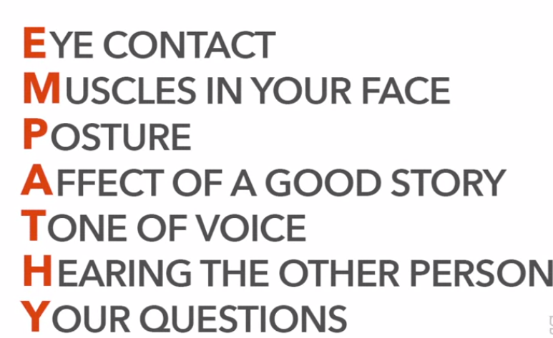
EMPATHY

Slide 46
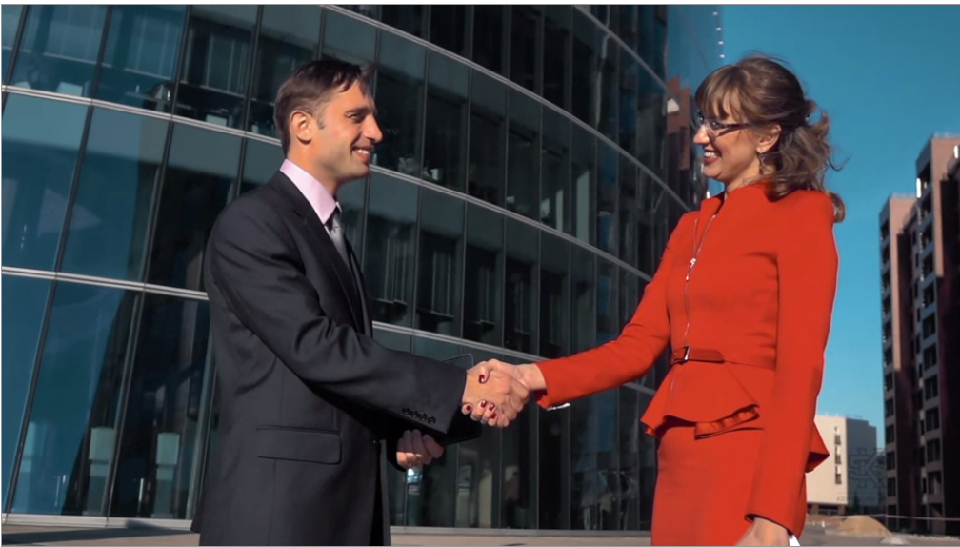
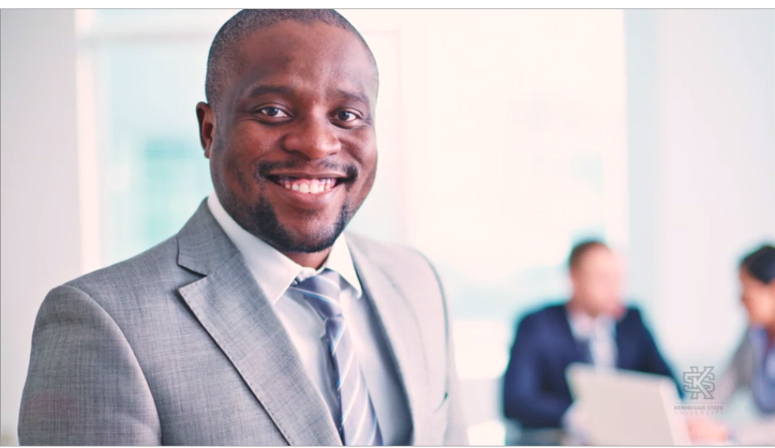
E-EYE-CONTACT
All human beings have the innate desire to be seen.
So it's very important to make good eye contact with the people we meet, especially the people we meet during the job interview process.
We definitely need to make good eye contact when we offer a person a firm handshake.

Slide 47
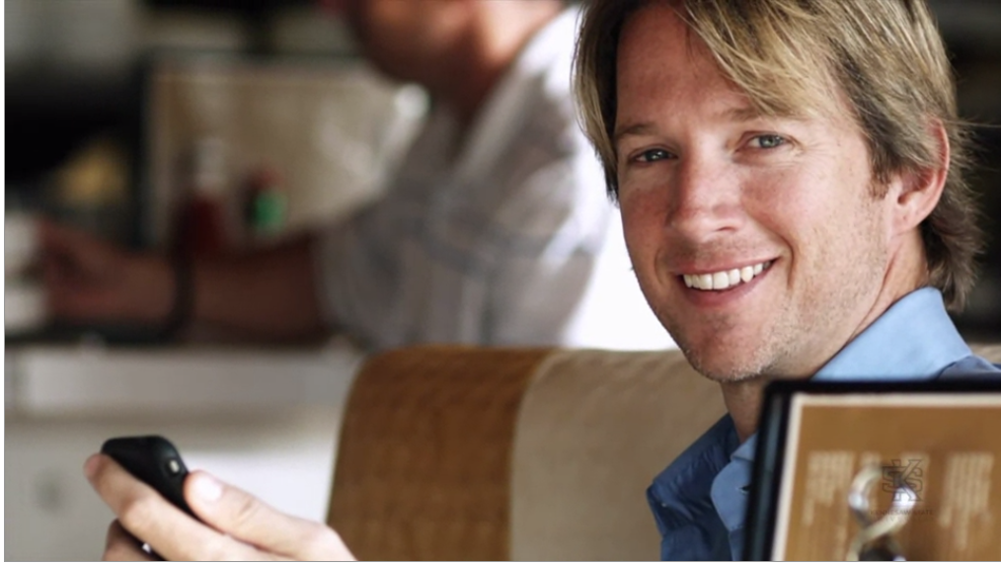
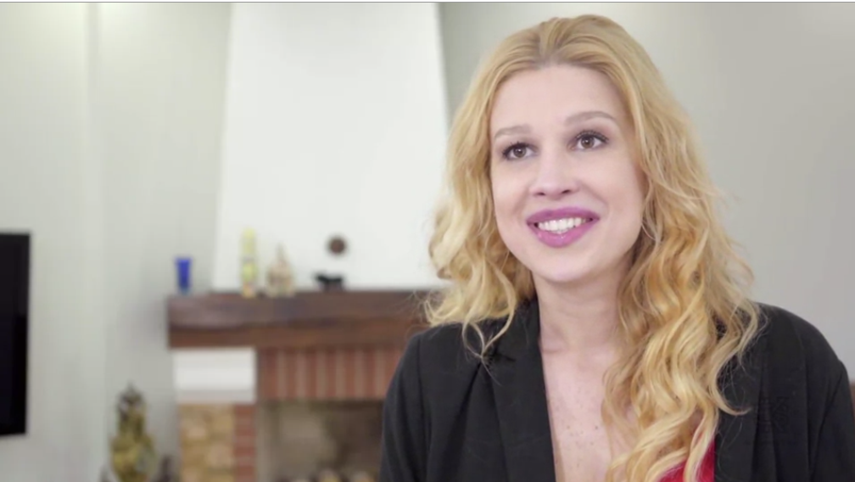
M-MUSCLES IN YOUR FACE
The M stands for the muscles in our face.
A person can learn a lot about us by watching our facial expressions.
During a job interview, we need to be upbeat/cheerful, interested and interesting and likable.
It begins with our smile.

Slide 48


P-POSTURE
The P stands for posture.
This behavior includes the body posture, our hand gestures, eye movement and the use of space.

Slide 49


A-AFFECT OF A GOOD STORY
The A stands for the effect a good story has on another person.
Stories are a universal language of thoughts.
We all appreciate a good story, one where we can share feelings of joy or hope or conquering a challenge.
Sharing a good story can give even the most averse people a sense of commonality and community.

Slide 50

T-TONE OF VOICE
The T stands for tone of voice.
It's our tone of voice that tells others how we feel about our message, and it will influence how they will feel about our message.
We need to speak at the right pitch, at the right speed for the situation.
When we're in front of a big crowd, we need to be proud and loud.
Don't be afraid to speak up.

Slide 51
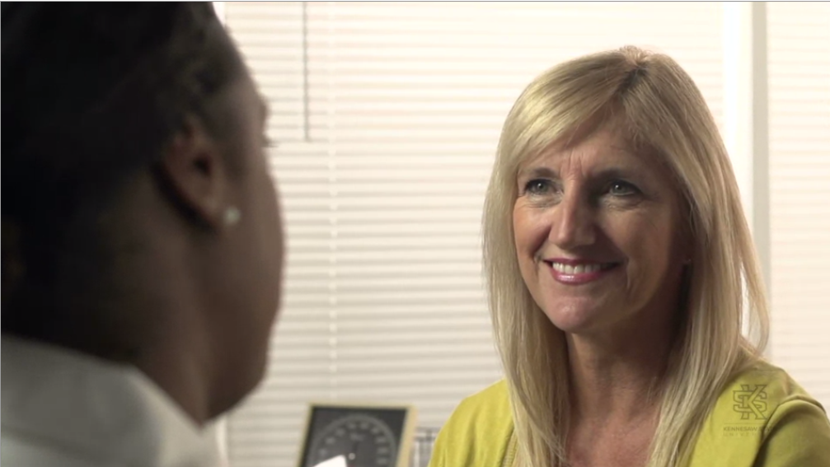
H-HEARING THE OTHER PERSON
The H stands for hearing the other person.
Listening is one of the most important skills we can have in life, both at work and at home.
We probably spend more time using our listening skills than any other kind of skill.
Like other skills, listening takes practice.
We need to both hear and understand the other person.

Slide 52

Y-YOUR QUESTIONS
If we want to make a big first impression, we need to ask quick questions too.
But we don't want to ask too many questions that can be sometimes annoying.
Arrive at the interview with three questions that we want to ask.
For example, a good question might be, I see that your company has five core values and then you would repeat those values to them. As you look at the company's future, which core value do you think is most important?

Slide 53

PROMOTE YOURSELF
Four Components to Promote Yourself
Know your intentions
Promote what you believe in and own it
State the Value Proposition First
Be Yourself

Slide 54
1. Know your intentions
Knowing yourself, your intentions, what you want and don’t want, and what you will and will not share is as important in shaping how you promote yourself as is what you promote.
You need to go into any opportunity with the end in mind.
But….be cognizant of the difference between self-promotion and shameless self-promotion.
It’s the difference between promoting “me” and promoting “we”.

Slide 55

2. Promote what you believe in and own it
Introduce yourself; reflect on your ideas and solutions .
Share examples, show your passion, translate the difference you have made, and most importantly focus on for whom.
When you let people know what you stand for, what you believe in, and how you can improve conditions associated with your beliefs, you are sharing authenticity.

Slide 56

3. State the Value Proposition First
The value proposition- “what’s in it for me”.
Your audience is listening for solutions to their problems, for benefits to their organization, and/or for truly interesting information that adds value to their knowledge base.
They are not listening to simply allow you to state fact after fact, accomplishment after accomplishment, or skill after skill. Boring……and also somewhat obnoxious.
They are listening for the value proposition. So, start with it first. Snag their interest.

Slide 57

4. Be Yourself
We’ve often heard the saying, “fake it ‘till you make it”.
But its purpose is to solve a problem temporarily.
When you are self-promoting, the person you are promoting needs to actually be who you are…not a manifestation of who you’d like to be or believe you should be.
If you’re not naturally loud and outgoing, don’t try to be. Quiet is just as good.

Slide 58
TOP 10 MOST WANTED SKILLS IN INTERVIEW
10. Problem Solving Skills: Employers want to know you can make decisions. You can solve problems.
9. Planning and Organization: You know how to plan and organize your time. Managers want to know you can set goals and reach them.
8. Flexibility and Adaptability: Organizations expect you to be flexible and adaptable. You can manage multiple assignments and tasks, you can set priorities, you can adapt to changing conditions, and work assignments.
7. Interpersonal Skills: You have good interpersonal skills, you have a high emotional IQ, you know how to get along with others, and minimize conflict. Employers want to know you can relate to other people and cultures with sensitivity and awareness.
6. Strength of Character: you are honest, you have integrity, loyalty, strength of character. Your supervisor certainly expects you to be trustworthy and honest.

Slide 59
TOP 10 MOST WANTED SKILLS IN INTERVIEW
5. Technical Skills: you have the skills you need to actually perform your work. Firms want you to know you have the skill set to do the job, of course. But that's not all.
4. Teamwork: You can work confidently within a group., You let your voice be heard and respect what others have to say. Because so many jobs involve working in groups, employers want you to be able to work well with others. To fit in with the team.
3. Self-Motivation: You are a self motivated person, you take initiative, you work hard. Organizations don't want people who always have to be told what to do. They want you to take responsibility for your work.
2. Evolutionary Skills: You know how to learn, and how to continually improve. Every potential employer wants to know you can grow and evolve in your work. And now the number one skill that employers are looking for.
1. Communication Skills: you are a clear, concise, and effective communicator. Employers want you to be able to speak and listen effectively.

Slide 60
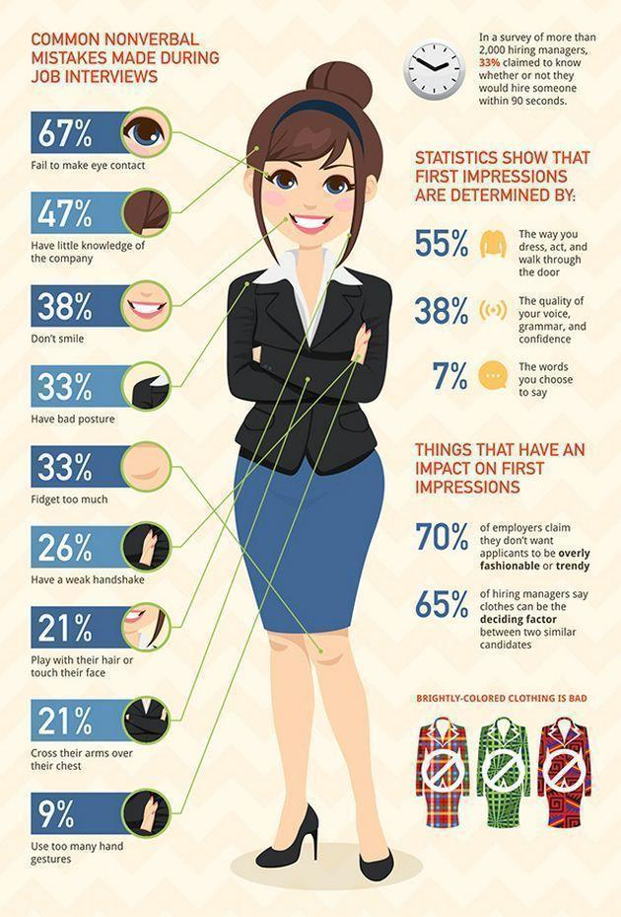

Slide 61
10 Tough Interview Questions and Ten Great Answers
Visit the following link:
https://collegegrad.com/mastering-the-interview/ten-tough-interview-questions-and-ten-great-answers

Slide 62
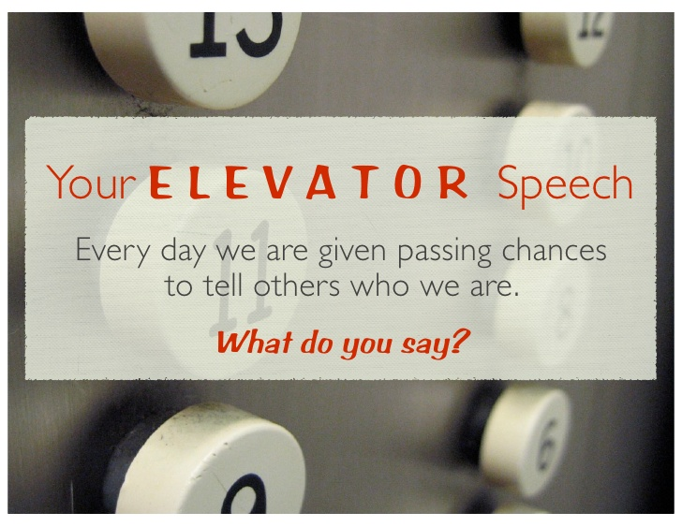
The 30 Second Elevator Speech
An elevator speech is a clear, brief message or “commercial” about you. It communicates who you are, what you’re looking for and how you can benefit a company or organization.
It’s typically about 30 seconds, the time it takes people to ride from the top to the bottom of a building in an elevator.
The idea behind having an elevator speech is that you are prepared to share this information with anyone, at any time, even in a short elevator ride.

Slide 63
Continued..
It is important to have your speech memorized and practiced, as this is really just about you!
No one knows you better than you do. Your elevator speech needs to sound natural, flow quickly, and leave the person you just spoke to with a clear understanding of who you are, what you can do, and what you would like their assistance with.

Slide 64
AN ELEVATOR SPEECH OUTLINE
Most Important 10 points:
ABOUT YOU
1. Smile to your counterpart, and open with a statement or question that grabs attention: a hook that prompts your listener to ask questions.
2. Tell who you are: describe you, and if you are currently working, your company.
3. Tell what you do and show enthusiasm.
WHAT DO YOU OFFER
4. Tell what problems have solved or contributions you have made.
5. Offer a vivid example.
6. Tell why you are interested in your listener.
WHAT ARE THE BENEFITS
7. Tell what very special service, product or solutions you can offer him or her.
8. What are the advantages of working with you? How or in what ways do you differ from others?
HOW DO YOU DO IT
9. Give a concrete example or tell a short story, show your uniqueness and provide illustrations on how
you work.
CALL FOR ACTION
10. What is the most wanted response after your elevator speech? Do you want a business card, a
referral or an appointment for a presentation after your elevator speech?

Slide 65
WORD LIMIT OF ELEVATOR SPEECH
The elevator speech is:
absolutely not longer than 25 to 30 seconds
or - in words - approximately 80 to 90 words
or - in sentences- 8 to 10 sentences

Slide 66
Tips
Rehearse your 30 second elevator speech with a friend or in front of a mirror.
The important thing is to practice it OUT LOUD.
You want it to sound natural.
Get comfortable with what you have to say so you can breeze through it when the time comes.

Slide 67
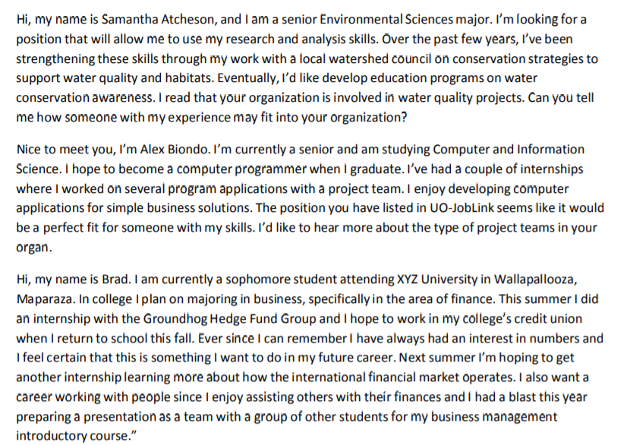
Examples of Elevator Speech-University Students

